Slide 1
DQN vs Double DQN on Atari Pong
CSCI 166
Fall 2025
Isac Lopez

Slide 2
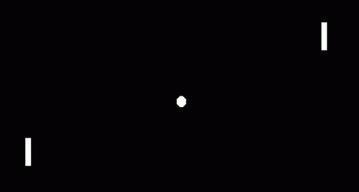
Motivation
Pong is a classic RL benchmarking environment
Simple discrete actions
Ideal for comparing DQN variants

Slide 3
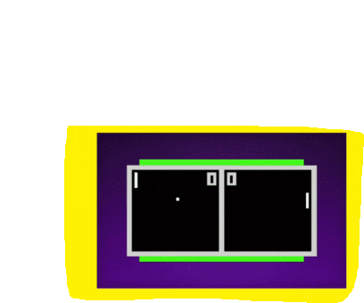
Environment
Observation: (4, 84, 84) stacked frames
Actions: NOOP, UP, DOWN
Sparse rewards: +1 / -1

Slide 4
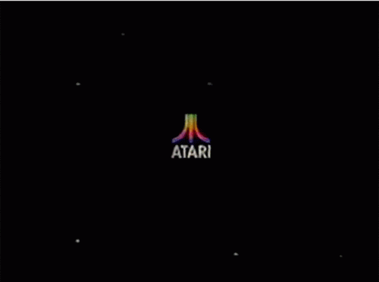
Baseline DQN
ConvNet → FC → |A|-
Experience replay
Target network
Epsilon-greedy exploration

Slide 5
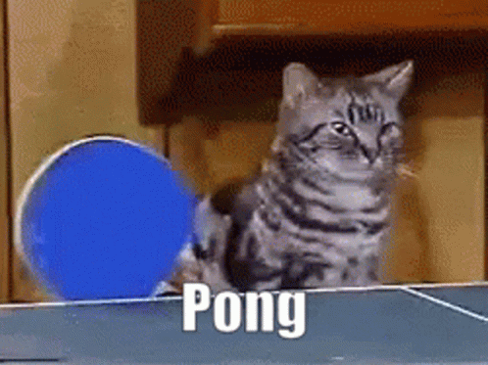
Double DQN
Fixes Q-value overestimation
Online net selects action
Target net evaluates action
More stable learning

Slide 6
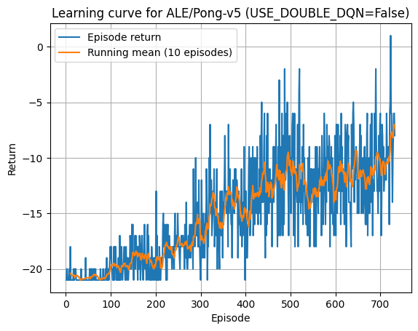
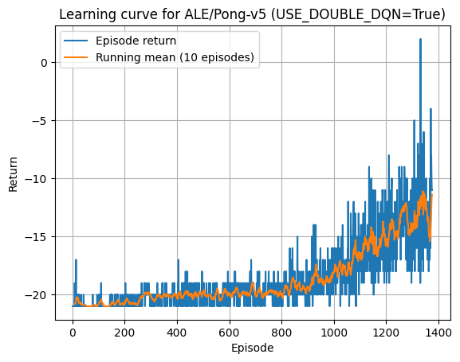
Results
Baseline: noisy, unstable Double DQN Results
Double DQN: smoother, faster improvement
Better Q-value stability

Slide 7


Baseline DQN: Early
Double DQN: Early
Early policy: random paddle movement

Slide 8


Baseline DQN: Learned
Double DQN: Learned
Learned policy: controlled, tracks ball

Slide 9

Reflection
Sparse rewards were challenging
Double DQN improved stability
Future: PER, N-step, Dueling, sticky actions

Slide 10
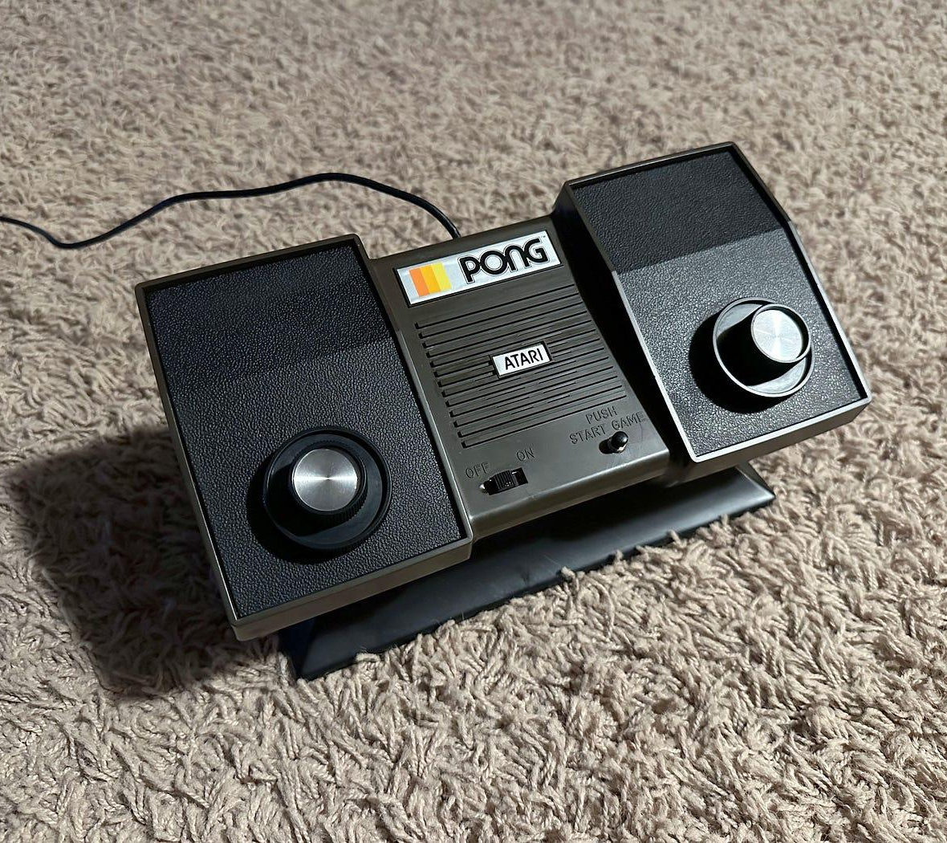
Conclusion
Implemented DQN + Double DQN
Compared learning curves & gameplay
Clear benefits to Double DQ

